Slide 1
Disclosure Tracking and
Accounting
Role-Specific HIPAA Training
Level 3
Presented by:
The UF Privacy Office
For personnel authorized to use the University of Florida's web-based Disclosure Tracking System

Slide 2
Before you begin...
You must be a designated user of the UF Disclosure Tracking System - that is, your department or clinic has authorized you to enter data into this system.
You are ready to begin if:
  You have completed:
    HIPAA & Privacy - General Awareness Training
    Notice of Privacy Practices Training
  You have read through the Operational Guidelines for Health Information (on this website) or
  You attended the class for: HIPAA Level 2 - Privacy Policies and Procedures (mostly UFP staff)
If you have not completed these, do not continue with this tutorial until all requirements are met!

Slide 3
Why are we doing this?
Both state and federal laws require UF to be able to “give an accounting” – to make a complete list – of all disclosures of a patient’s health information, if asked to do so.
  All disclosures means any “release, transfer, provision of access to, or divulging in any other manner, of information to persons or organizations outside of the entity holding the information.”
  There are a few exceptions to that definition:
    Disclosures made directly to the patient;
    Disclosures that were authorized by the patient;
    Disclosures made to others solely for treatment of the patient;
    Disclosures within UF to carry out health care business operations.

Slide 4
So, if a Patient asks...
... for a list of all disclosures of her personal health information, UF must provide such a list within 60 days of receiving the written request.
This list would only include disclosures that the patient does not already know about – that is, disclosures:
  Not made directly to the patient
  Not authorized by the patient;
  Not related to providing treatment for the patient;
  Not used by UF for internal health care operations.

Slide 5
What disclosures?
You may be asking, “What kind of disclosures would UF make that patients may not know about?”
There are actually several kinds of these disclosures; they include:
  Mandatory disclosures required by law:
    Reporting suspected abuse or neglect to the Abuse Hotline
    Reporting adverse drug reactions to the FDA
    Reporting injuries inflicted during a crime to the police
  Some researchers are authorized to make limited disclosures for research, under a Waiver of Authorization.
  And accidental or illegal disclosures, once discovered
If you would like more examples, a complete list is on this website.

Slide 6
How do we track these disclosures?
When HIPAA began, these disclosures were tracked on a paper form kept in the patient's paper chart.
Now, many disclosures are tracked in the patient’s electronic health record, either automatically, or by manual entries.
All other disclosures must be manually entered in UF's on-line database – the DTS – Disclosure Tracking System
Disclosures should be entered:
  By the clinic or department that made the disclosure,
  At or as close to the time of disclosure as possible. (Don't save up multiple disclosures and enter them all at once!)
The information is then held in the database for at least six years.

Slide 7
What Kind of Data?
The Tracking System will ask you to enter:
  The patient's name and other identifying information
  The date of the disclosure
  The person or entity that received the information and their address (if known)
The system will give you choices for:
  The type of information disclosed
  The purpose of the disclosure

Slide 8
What NOT to Track...
Do not enter:
  Disclosures made to insurance companies for billing purposes.
  Disclosures made to the Health Department about :
    Communicable diseases
    Immunizations/vaccinations
  Disclosures made to the Cancer Registry about new or recurring Cancer cases
These disclosures are authorized by the patient when they sign the Consent for Treatment.

Slide 9
More of what NOT to Track...
Do not include verbal disclosures made to a patient's family members or friends who are directly involved in the patient's care.
Do not include attorney requests for records for which the patient has signed an authorization.
Do not include disclosures of “de-identified” health information or data included in officially sanctioned limited data sets.
  If you’re not sure if information is de-identified, or if you’re not sure about a limited data set, please call the Privacy Office.

Slide 10
What If I'm Not Sure or Forget?
When in doubt, go ahead and enter the data in the Disclosure Tracking System - it will not hurt to have too much information!
If you forget to enter the data, there is no back-up, and so there would be no way to honestly answer a patient’s request for an Accounting - it will definitely hurt to not have enough information!
Data entered late is better than no data at all!

Slide 11
Who Can Use the System?
Only authorized users may enter data in the system.
  Sometimes you may be instructed by the Privacy Office to enter a disclosure.
  If a disclosure meets the definition for tracking, please enter it in the DTS – do not wait.
Only the Privacy Office may access information in the system and respond to requests for Accountings of Disclosures.
  If you or your clinic/department receive a request for an Accounting of Disclosures, refer the request to the Privacy Office immediately.

Slide 12
How does the system work?
To access the Disclosure Tracking System:
  Go to: https://dts.privacy.ufl.edu
  Log in using your Gatorlink ID and password (Note: If you’re already logged into MyUFL, you may not need to log in to the DTS system.)
    Note: the first screen can take several seconds to appear, so be patient.
  Follow the onscreen directions – see the following slides for more explanations.
    If you wait too long between screens, you may have to “refresh” the screen and re-enter data.
Remember, you can always come back to these training slides to refresh your understanding – and you can always call the Privacy Office for assistance.

Slide 13
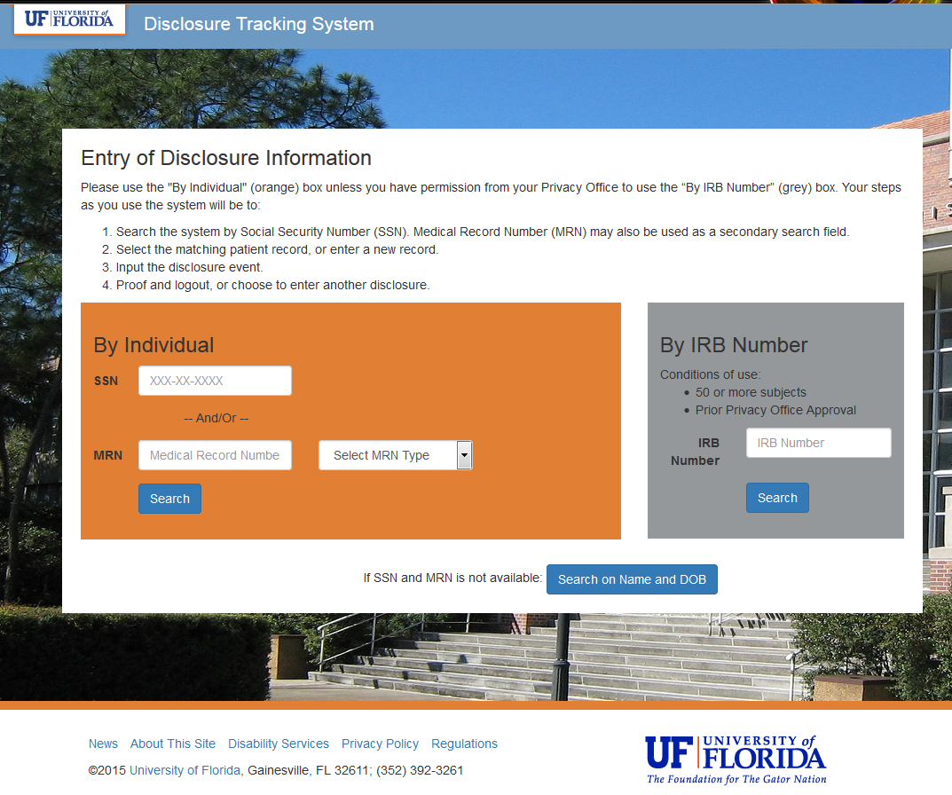
Step 1: Enter "By Individual"
If you have the patient’s Social Security Number, enter it here.
Or enter a Medical Record Number and indicate the type
Then click
Search
If neither number is known or no match is found, click Search on Name and DOB

Slide 14
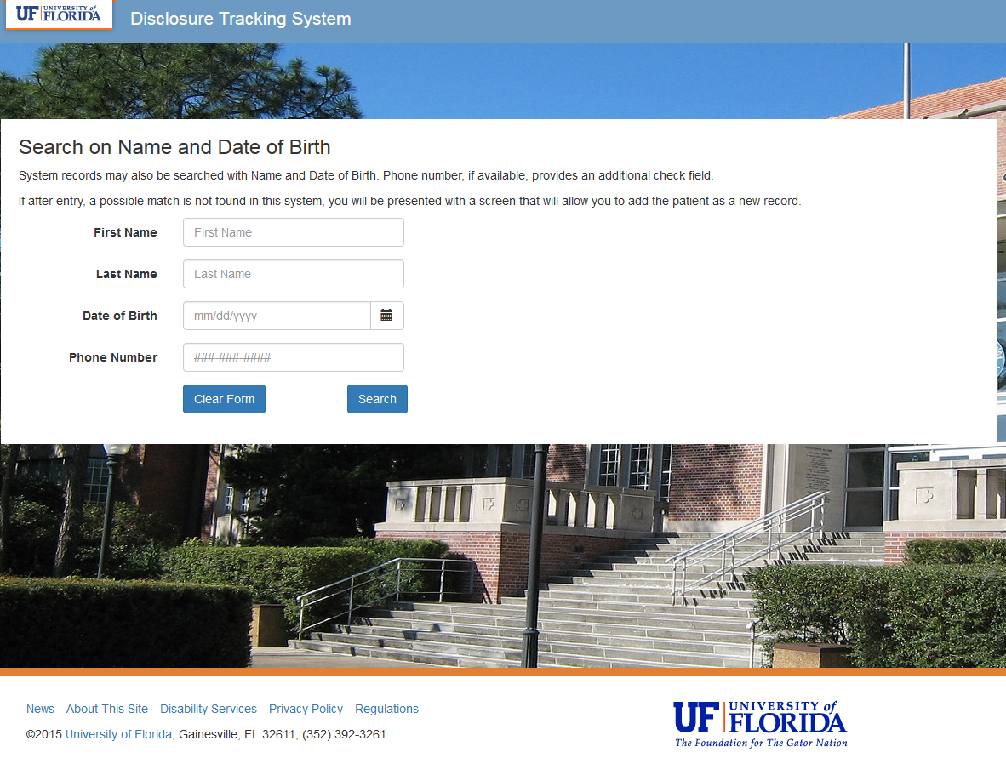
Step 2: Find existing patient…
If the patient’s ID numbers are not known, or not found in the system, enter the patient’s name, date of birth, and phone number (if known) to try to find a match.
Click Search
This will also start a new disclosure record, if no match is found.

Slide 15
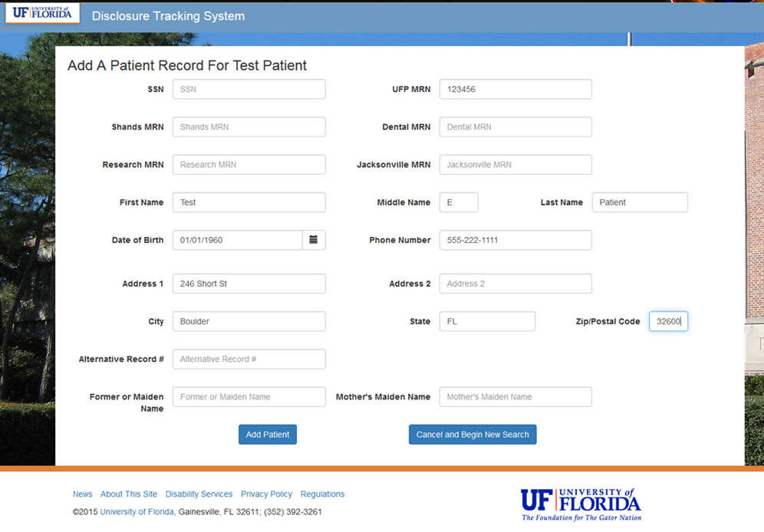
Or, add the patient, if new
If no match is found, you may now add the patient’s ID information as a new entry. Enter all available data for this patient and click Add Patient.
If you are certain the patient already has an entry, you can Cancel to begin a new search.

Slide 16
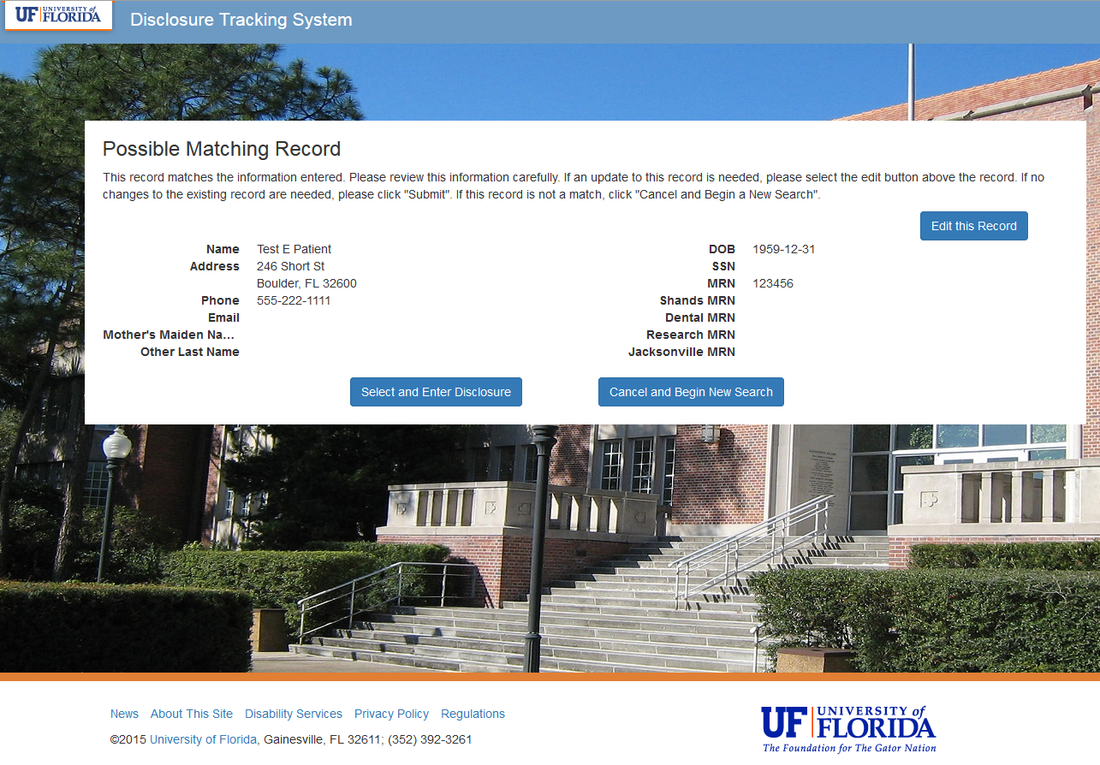
Step 3: Review the Data Entered
Review your entries to Add the patient or ensure a match. Then choose Select and Enter Disclosure to continue.
If anything is incorrect, use the Edit this Record button to make corrections.

Slide 17
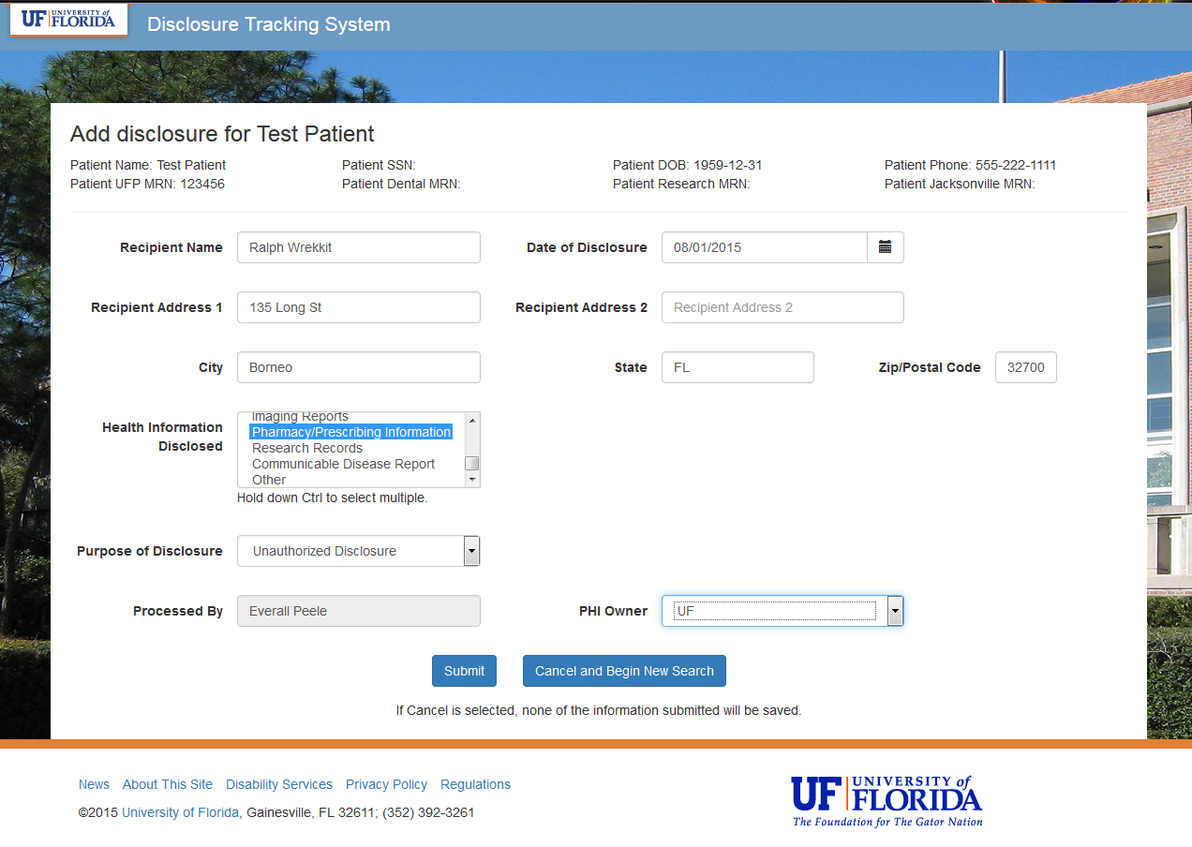
Step 4: Enter disclosure data
Enter all information known about the disclosure.
Be sure to hold the Ctrl button to select more than one type of Health Information Disclosed.
When all available data is entered, click Submit.
Sally C. Tuit

Slide 18
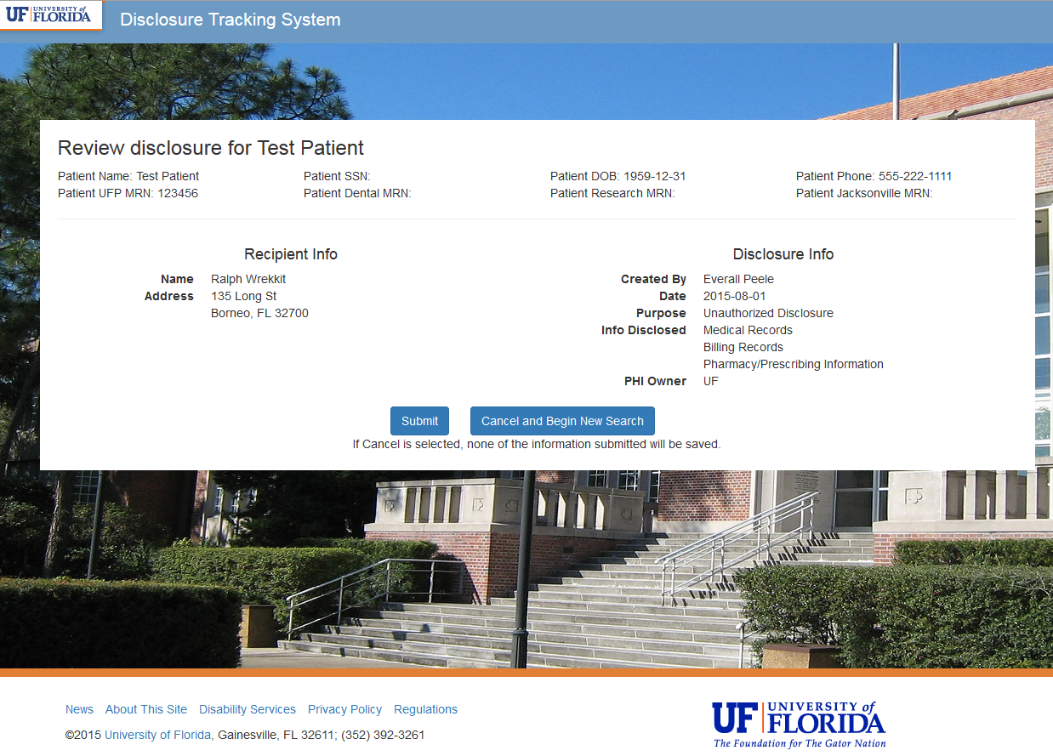
Step 5: Confirm and submit
Once again, review the information you have entered, and if all is correct, click Submit.
If corrections are needed, use the Edit this Record button.
Sally C. Tuit

Slide 19
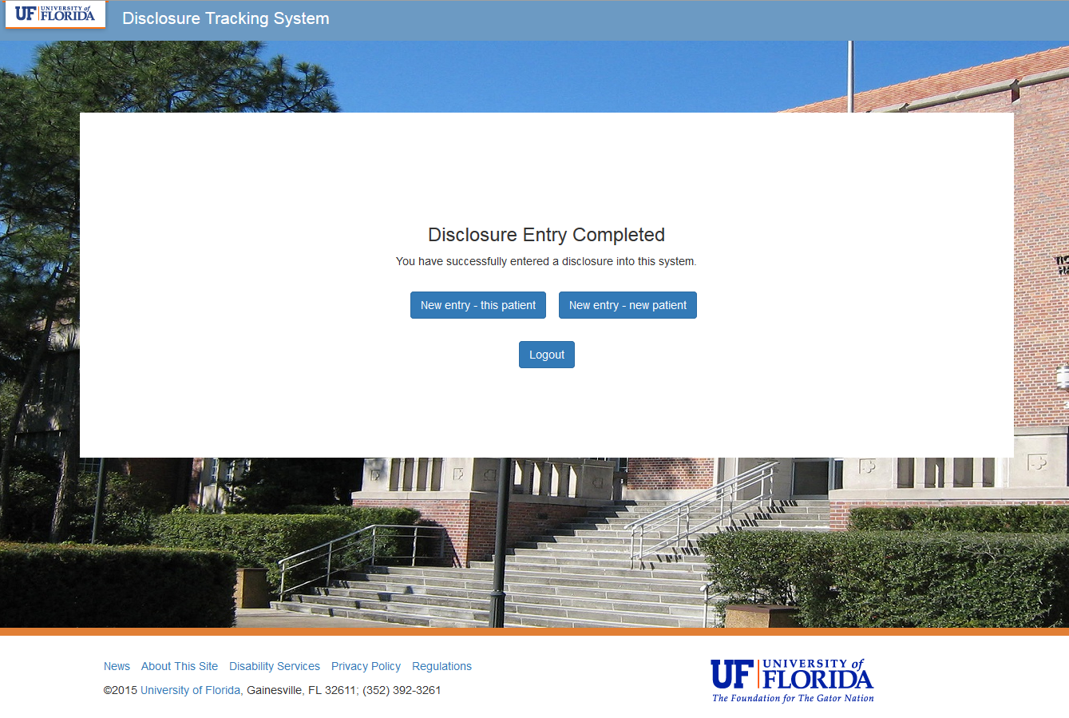
Finished!
Make your selection on this screen:
Continue entering disclosures, or
Logout of the DTS.

Slide 20
What Now?
Congratulations! You have completed the training.
Complete the Application for Access form and have your supervisor approve it. The link to the form is available at http://privacy.ufl.edu/uf-health-privacy/accounting-for-disclosures/.
Email the completed Application for Access form to your Department Security Administrator (DSA).
  For list of current UF DSAs, see http://files.it.ufl.edu/identity/DSA.pdf.
  UFHealth and UFHealth Jacksonville personnel should email the form to IAM-SHANDS-IDM-L@LISTS.UFL.EDU.
You will receive a confirmation email from the Privacy Office once you are an approved DTS User.
Log into the DTS at https://dts.privacy.ufl.edu/. This link will first require you to authenticate your GatorLink account. You will then be directed to the Disclosure Tracking System.

Slide 21
Questions?
Check the Privacy Office website for more information and additional resources about the DTS at http://privacy.ufl.edu/uf-health-privacy/accounting-for-disclosures/.
The Accounting for Disclosures policy is available at privacy.ufl.edu > UF Health Privacy > Policies & Procedures > Operational Guidelines – Health > Open the Word document and scroll down to ‘4.7. Patient’s Rights: Accounting for Disclosures.’
If you have questions or concerns, call the Privacy Office at 352-273-1212, or email us: privacy@ufl.edu

